Slide 1
Data structures
Collections, arrays, lists etc

Slide 2
Objectives
Understand why we might need a collection?
Define different types of data structures
Deep dive into arrays:
Defining new arrays
Accessing arrays
Iterating through arrays

Slide 3
Why Use Data Structures?
If we have one or two variables, we define them individually.
When this number increases it is difficult to define each variable individually (imagine defining 20 strings in your code!).
For this we use a data structure or collection.
This collects similar types together and allows us to define space for several values but as one variable.
The important part of these structures are that they are always collected in groups of the same types.

Slide 4
Data Structure Types
Arrays – Staticly sized collections
Lists – Dynamic arrays that automatically resize to accommodate the length of the collection.
Linked List – This collection is like a list however its backend functionality changes slightly in that it's not linear in memory. Instead, each element points to the next element in the list. Hence the name Linked!
Dictionary – This is a key value pair, typically the key being primitive types, with the value being more complex.
Binary Tree – This is a node-based collection where each node has two children (left and right) that extends downwards to form what visually looks like a tree!

Slide 5

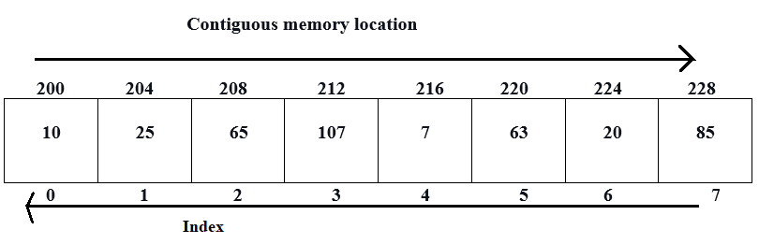
Arrays
Arrays are set sized collections.
Think of it like this:
If I want to have 12 horses, I must put them in at least 12 Stables.
In this analogy the stables are our array. It houses our horses and is a space that we can put them into.
Back to C# when we define an array it allocates the space in memory similarly.
C# allocates the memory equally for each object * the number of objects in the array one after another.

Slide 6
Arrays
A Stable can have a horse in it or it can be empty.
Similarly, our array can have empty elements.
Each element in our array is also assigned an index.
An important note is that the array index starts at 0.
This helps us keep track of which element we're in.
It also means we can easily access each element as the element size is fixed.

Slide 7
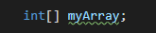
Array Definition
In C# we define an array similarly to how we define a regular variable.
We start with its type then an identifier, and optionally some value.
Defining a basic array of ints looks like this:
The only difference here is the use of '[]' brackets after the type.
This tells C# that we're defining a new array of that type instead of a regular single version.
This can be repeated with almost any data type to create an array of that type...

Slide 8
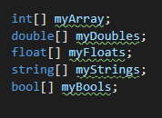
Array Definition

Slide 9
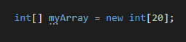
Array Initialisation
Just like a normal variable these definitions do not have value they're null or empty.
In order to initialise and provide value we need to use a slightly new syntax...
Below we have an int array that has been initialised to a size of 20.
To do so we use the "new" keyword and then the type again with the brackets, this time we provide the size of the array; in this case 20.

Slide 10
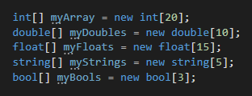
Array Defined and Initialised

Slide 11
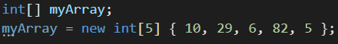
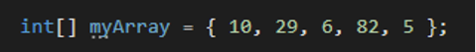
Array Definition and Value Assignment
Just like regular variables we can define, initialise and set values all at once for arrays.
Note that all values must be assigned too when using this method.
This can be done a few ways:
Full: (only needed when setting an array variable after declaration statement)
Shorthand:

Slide 12
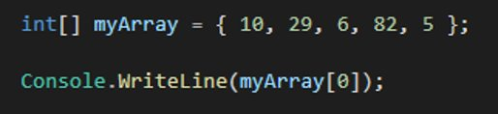
Array Access
To access an array, we use the identifier like we would a normal variable. By default, this refers to the whole array object.
For example: "myArray" is the whole array object.
To get a single value, we use the index value and our square brackets to target which element we're looking for.
In the below example myArray is an array object whereas myArray[0] is an int object:

Slide 13

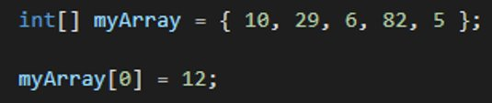
Array Access
This returns the single value that is contained within the array at that index.
We can also think about this like a variable.
So, we can assign values to these using the same syntax as a normal variable.
Replacing the value 10 in index 0 with the value 12.

Slide 14
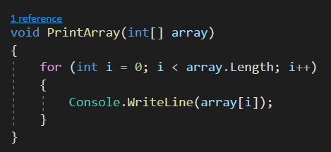
Iteration of Arrays (For)
We can use loops to iterate over an array.
To print all items in an array we can create a for loop and use the "i" or index to repeat the same code.
As the index value increaments, it runs the code over each element in the array.
Combine this with a simple Console.WriteLine() we can get the following:

Slide 15
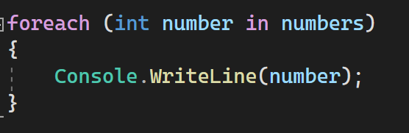
Iteration of Arrays (Foreach)
We can also use a Foreach loop to iterate over each item in the collection and use a single variable.
Each iteration of a foreach the variable defined is replaced.
Until the loop reaches the end of the collection.

